Slide 1
The Idea
B&A Covers will help the people who do not have a garage. Some people have to leave their vehicle out when it is cold. The next morning they will have to get frost or snow off their vehicle and that can take some time.

Slide 2
The Industry
Leather and Allied Product Manufacturing- Manufacturing leather and similar material.
NAICS 316
The projections of the industry are to stay in America and not be sent off to foreign places. Manufacturing is becoming more efficient, cheaper and easier.
The labor has increased 15% in the last 5 years.

Slide 3
The Business Model
The purpose is to help people save time during the winter or prevent accidents. Every vehicle will be a custom fit with different prices depending on how much material is used. Straps fit through the top of the door so you can shut it in the door and lock it.

Slide 4
The Product
We have created a product to protect the windshield of a car - it is created to cover and protect car windows from the frost and snow. Our product material is made of fiber and ballistic nylon and is guaranteed not to tear, get wet or damp, and is waxed over on the outside with softer woven cotton underneath to protect the windshield and our material can be patented.
Competition products include a windshield frost protectant spray. However, this requires repeated purchases.

Slide 5
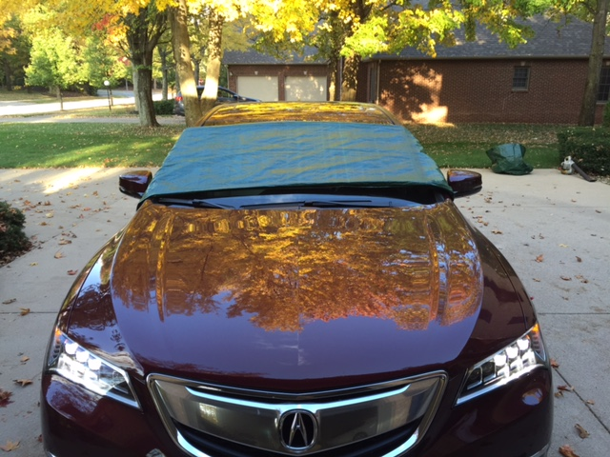

Slide 6
The Customer
People who cannot park their vehicle in a place where it will not get frost or snow on the windshield.
Apartment dwellers
Older homes with no garage
Individuals who work 3rd shift

Slide 7
The Targeted Customers
Apartment dwellers (Depending on how many every day drivers they have)
Home owners with not enough garage space or no garage
All regions except West Coast and South. Canada would be a huge market.

Slide 8
The Market
Many new houses are being built without garages thus increasing the danger of drivers without clear windows.
Source
Americans living in apartments | 16,864,947 occupied apartments. More than half get to work by car.
Hoosiers living in apartments. | 539,677
Seymour locals living in apartments | 3,571
U.S. citizens with no garage homes | 82% of homes have a garage, but only 15% have room for there car.

Slide 9
Target Market Strategy
“Not an early bird, we’ll help you save time”
Pricing will be the same for every car.
We will custom the size to fit your windshield perfectly.
You can order it online and it will will be shipped to your doorstep for free.
Retail stores will have some in stock, but they will not be custom fit.
Auto zones, O’Reilley’s, Clint Payton

Slide 10
Target Market Descriptions
Description | Target Market #1 | Target Market #2 | Target Market #3
Name | Indiana | Northern states | Canada
Description | People who live in apartments or in a house with no garage | People who live in apartments or in a house with no garage | People who live in apartments or in a house with no garage
Demographics | Potentially 227,950 drivers in the area could have cars and need our product. | Drivers ages 18 to 84 | Potentially 20,000 drivers in the area could have cars and need our product.
Buying Behavior | One to three time purchase, 10 year guarantee. | Depending on how many cars they own, usually a one time purchase. | Depending on how many cars they own, usually a one time purchase.
Size (numbers/dollars) | Potential drivers needing our product could be 25% | Millions of drivers, will be huge profit. | Canada is very cold so potential drivers would be 35%
Projected Sales | (30,000)(28)= $840,000 | $2,750,000 | 7,000(28) $196,000
Trends | First line of defense in protecting your windows from the elements is to cover them. | Used for most of the year, probably 7 or 8 months | Used for all but 2 months, canada stays very cold.

Slide 11
Target Market Strategies
Strategy | Target Market #1 | Target Market #2 | Target Market #3
Positioning Message | Cover that saves time during cold months. | Cover that is used for more than half of the year | Cover that is used all but two months
Pricing | $35-$40 depending on the car model | $35-$40 depending on the car model | $35-$40 depending on the car model
Product Customization | fits the car you own | fits the car you own | Fits the car you own
Distribution | They all will be shipped out of our warehouse | They all will be shipped out of our warehouse | They all will be shipped out of our warehouse
Contact Sphere | Car Dealerships, Auto Cares, and Business Networking International | Car Dealerships, Auto Cares, and Business Networking International | Car Dealerships, Auto Cares, and Business Networking International
Advertising | Twitter, Facebook, Billboards, Commercials, Car Magazine ads. car fax, craigslist, autotrader | Twitter, Facebook, Billboards, Commercials, Car Magazine ads. car fax, craigslist, autotrader | Twitter, Facebook, Billboards, Commercials, Car Magazine ads. car fax, craigslist, autotrader
Public Relations | Grand opening newspaper and radio invited
Personal Selling | We will go out and market the product
Sales Promotions | First 4 months 15% off | Buy 1 get 1 25% off | Buy a car get it with the car

Slide 12
The Competition
B&A windshield covers are custom fit to a car, so the windshield is clear with no spots of frost. B&A covers are made thick and warm. The cover keeps the windshield insulated and protected from snow and ice.
There is an anti freeze spray but it uses chemicals unhealthy to the body, and its a repeated purchase.

Slide 13
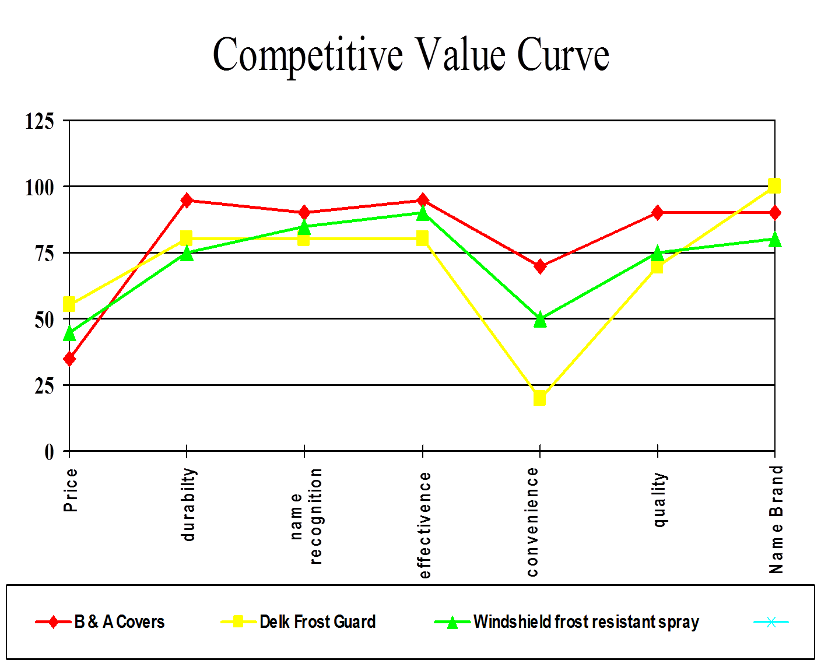

Slide 14
Competitive Analysis
COMPANY | WE CAN DO, THEY CAN’T | WE CAN’T DO, THEY CAN
Windshield frost resistant spray | Keep the windshield protected. Offer a product that will work continuously. | Do it the night before and not have to mess with it in the morning.
Delk Frost Guard | Offer a product guarantee. Custom Fit. | Offer different colors.
Weathertech | Keeps windshield from frosting. | Keep your car cool when it is hot outside.

Slide 15
The Message
Don’t like frost in the morning? Don’t worry, we got you covered. Our custom fit windshield cover keeps your windshield clear on a frosty morning.

Slide 16
The Sales Approach
Our customers can be found at car dealerships. Additionally, online through social media and a professional website.
Business Networking International - Central Indiana Branch.
Word of mouth

Slide 17
Target Market Sales Approach
Car dealerships will help to promote sales.
Twitter, Facebook, Billboards, Commercials, Magazine ads.
Car dealerships can offer a free cover with the purchase of a vehicle, and we go to car sales or Ipod Day and have a stand advertising our product.
Customers can come straight to us, and order the product out of our warehouse straight to their door.
We offer a product guarantee that gives you money back if the product doesn’t keep your windshield clear, or if the material rips.

Slide 18
The Marketing Schedule
Media |  | Annual Cost
Yellow Pages (South Central Edition)
 | Category: Cars, accessories | $3,200.00
Newspaper (Seymour Tribune)
 | Ad Design Costs | $800.00
 | Media Costs (24 ads @ $328) | $7800.00
Direct Mail (Brochures and Special Occasions)
 | Distribution (10,,000 @ $.50 per piece @ $.27 postage) | $5,700.00
Radio (QMIX 103 / Adult Contemporary & WTIU/NPR)
 | Media Costs (500 :30 second ads @ $6.20 per spot) | $3,100.00
Total Annual Advertising and Media Costs |  | $20,600

Slide 19
The Inner Workings
Production will be in a facility at Ranger Enterprises Bldg. 2 , Seymour IN 47274. We will be sharing this with another start-ups.
Production will be Monday through Friday 8-5, growing as needed.

Slide 20
The Location
Production will be in a facility at Ranger Enterprises Bldg. 2 , Seymour IN 47274
Sharing with the 2 other start ups.
Convenient because is in town.
Around many other factories.

Slide 21
The Management Team
Jacob Ahlbrand- Head of Sales and Distribution. Will overlook sales and take care of shipping | Nick Booth - Head of Production will make sure we have enough employers and time to have products done on time
Will higher a financial team to pay all bills and taxes, collect money and transfer to banks.

Slide 22
The Core Scores
We will record monthly sales.
We will document return customers
We will keep track of our different target markets
Surveys will be sent to all customers to determine how well our cover is working.

Slide 23
Risk Management
We will need Property Insurance we will split with our other 2 start ups from with Liberty Mutual.
We will need Health Care and people insurance for our workers from State Farm.
We will have liability insurance from Progressive.

Slide 24
Legal Structure
General Partnership.
Duration of Existence - If Booth or Ahlbrand die, the business will be 100% in the other’s name.
Liability - We take full responsibility if the product is defective or damaged your car.
Operational Requirements -We manufacture the product, sell to retail and have our own website, and store/warehouse.
Management- Booth owns 50%, Ahlbrand owns 50%
Taxation-partnership itself reports profits and losses to the IRS on a special form.
Pass Through Income/Loss- After all expenses are made, profit will split 50/50 between Booth and Ahlbrand.
Raising Capital- $30,000 coming from a Venture Capitalist.

Slide 25
The Money Forecast
The product will cost us $8.84, and will be retailed at $35.00.
Due to our product being seasonal, we anticipate sales beginning in October 2016, and ending around February 2017. Since we have a small selling season, we plan to draw in many customers, around 100 a month. This will draw in about $13,080 for our first season.
Payments for rent will $10 per SF for a year, and will need machinery.
Customers cover shipping.

Slide 26
Required Start-Up Funds
Item | Amount
Fixed Assets | $111310
-Building | $89000
-Land
-Initial Inventory | $5000
-Equipment | $1310
-Furniture and Fixtures
-Vehicles | $20,000
Working Capital
-Salaries and Wages | $6453
-Insurance Premiums | $208
-Leasehold Improvements | $1,000
-Rent and Utility Deposits
-Advertising and Promotions | $300
-Legal and Accounting Fees | $500
-Supplies | $700
-Cash on Hand | $5000
Totals | $12558

Slide 27
Capital Strategy
Total Amount Required | $123,868
-1 Investors ($30,000 each will get 25% share of company) | $30,000
-Commercial Bank Loan (Real Estate & 80% Building) | $71,200
-Owners
Loan Payment Amounts
Commerical Loan2 | $123,868
-Projected Interest Rate | 9.9%
-Term In Months | 84
Total Monthly Loan Payment | $957.04

Slide 28
The Next Steps
By October 10th we will have the warehouse.
By October 20th we plan to have a grand opening.
By October 21st start planning meetings with car dealerships and retail stores.
By December 10th ready in time for Christmas we plan to have a variety of colors.
In the next two years we plan to have covers for many motorized vehicles like a golf cart, John Deere Gator, and Polaris Rangers.
In the next two years we plan to be exclusive partners with a major store that sells our product.

